Slide 1
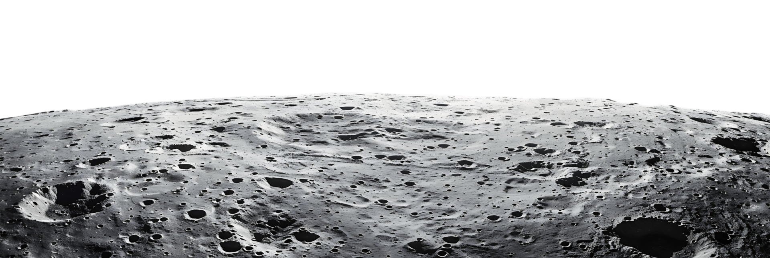
Virtual Moon Project
Emily Pearson
(Supervised by Andy Smith)

Slide 2
Project Overview
Return to the moon – lunar construction
Materials in the lunar environment
Recreation of lunar conditions to assess material suitability
Radiation – solar “cosmic rays”
Temperature variations (>250K range)

Slide 3
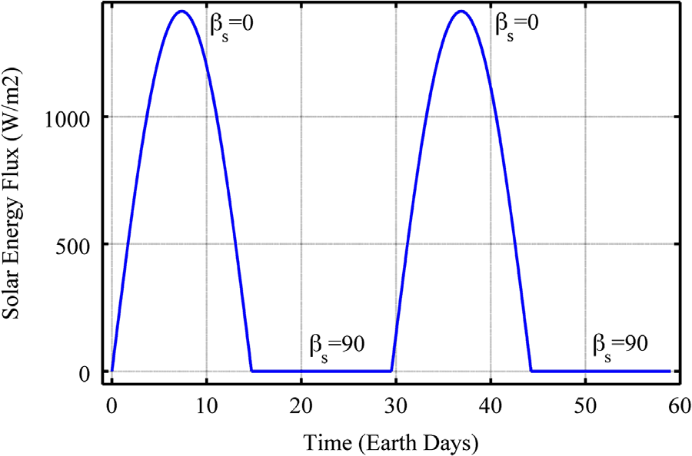
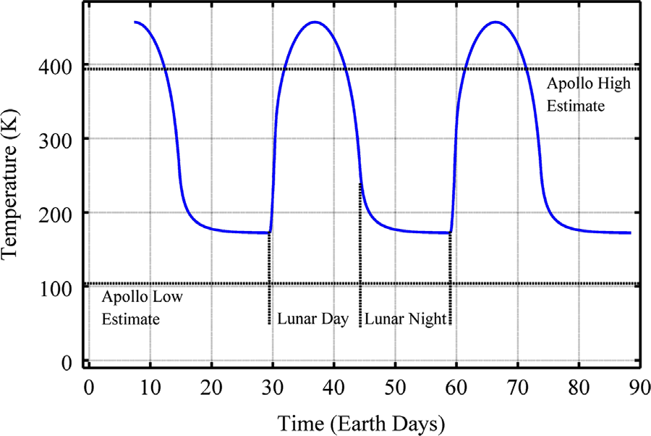
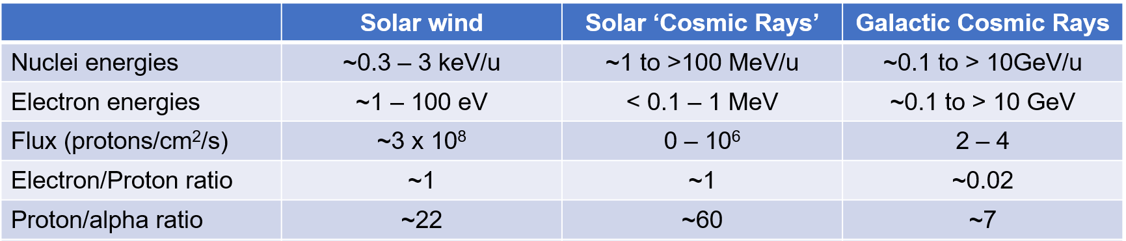
Solar radiation power
Lunar surface temperature
R.B. Malla, K.M.Brown; ActaAstronautica 107 (2015) pp.196–207
G.Heiken et al ‘The Lunar Sourcebook’ CUP (1991)

Slide 4
Temperature Cycling
Simulation of lunar day-night cycles over shorter timescale
Heating already available
Cooling cycle – nitrogen gas flow with liquid nitrogen heat exchanger
At lunar equator: -166°C to +114°C
R.B. Malla, K.M.Brown; ActaAstronautica 107 (2015) pp.196–207

Slide 5
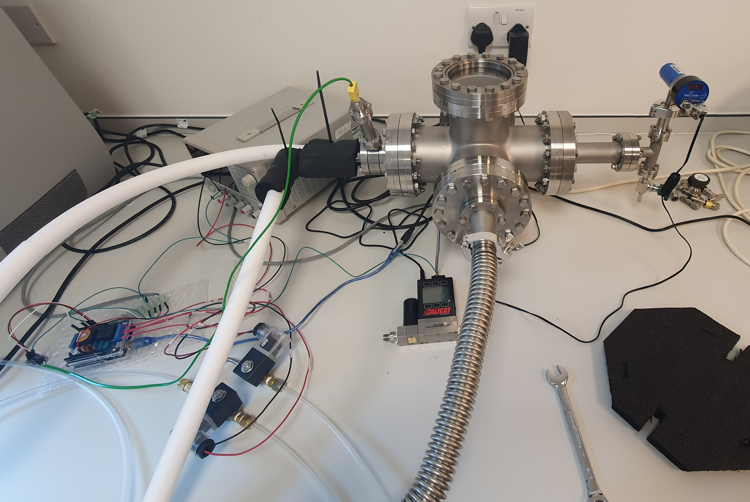
Experimental Setup
Vacuum chamber with cold finger
Liquid nitrogen heat exchanger
Mass flow controller – cooling rate regulation
Solenoid valves – two gas feed lines
One through LN2 heat exchanger
One bypass
Arduino-based electronics
Data sent to MATLAB for processing

Slide 6
Initial Testing – Problems Identified
Mass Flow Controller range
Max flow rate of 1 SLPM is insufficient for cooling
Poiseuille’s Law: assumes laminar and incompressible flow
Flow throttling

Slide 7
Initial Testing – Problems Identified
Nitrogen and liquid nitrogen supply
Higher flow rate of N₂ = rapid depletion
LN₂ boil-off rate increases with N₂ flow rate

Slide 8
Solutions
Alternative mass flow controller
Larger range required (ideal max. of 30 SLPM)
N₂ gas recirculation system
Prototype under construction
Pre-cooling of N₂ gas
On site LN₂ production unit?
Needed for long irradiations

Slide 9
Temperature Holding
Previous tests – potential for temperature holding identified
LN2 depleted and no N₂ flow → very slow warmup
Successfully tested:
-40°C to -35°C range
-60°C to -55°C range
Lower temperature ranges (e.g. lunar night) would require refills of liquid nitrogen

Slide 11
Project Summary
Successful demonstration of liquid nitrogen heat exchanger for cooling (to min. temps of -110°C and -132 °C)
Successful demonstration of regulated cycle to hold temperature within a certain range
Identified areas for improvement
Next steps: address current limitations → enable multiple heating and cooling cycles

Slide 12
Acknowledgements
Thank you to Andy and the accelerator team for all your help!
Thank you to everyone at DCF for welcoming me to the team this summer!

Slide 13
Questions?

